Slide 1

JAWAHARLAL NEHRU TECHNOLOGICAL UNIVERSITY HYDERABAD COLLEGE OF ENGINEERING NACHUPALLY (KONDAGATTU),JAGITIAL DEPARTMENT OF COMPUTER SCIENCE AND ENGINEERING Major Project Presentation on HANDWRITTEN DIGIT RECOGNITION USING CONVOLUTIONAL NEURAL NETWORKS
Esteemed Guidance Under:
Dr P.Sammulal
Professor of CSE Department,
JNTUHCEJ
Presented by:
A.Bhavani(17JJ1A0502)
A.Manogna(17JJ1A0503)
T.Sushmitha(17JJ1A0550)

Slide 2
CONTENTS
Introduction
Project Objective
Machine Learning vs Deep Learning
Training Dataset
Imported Libraries
Neuron
Neural Networks
Why CNN?
CNN Architecture
Layers of CNN
Loading Dataset
Creating a Deep Neural Network Model
Prediction using the model
Conclusion

Slide 3
INTRODUCTION
Humans can see and visually sense the world around them by using their eyes and brains.
Computer vision works on enabling computers to see and process images in the same way that human vision does.
Several algorithms developed in the area of computer vision to recognize images.
The Handwritten Digit Recognition problem becomes one of the most famous problems in machine learning and computer vision applications.
Handwritten digit recognition is the process of receiving and correctly interpreting a legible hand-drawn digit from an input source (paper or photographs) by comparing it with previously trained data.
The goal of our work will be to create a model that will be able to identify and determine the handwritten digit from its image with better accuracy using the concepts of “Convolutional Neural Network” in Deep Learning.

Slide 4
PROJECT OBJECTIVE
Our objective is to achieve comparable accuracy by using pure CNN architecture.
To improve the accuracy of detection.
To develop a method which is independent of digit size and style.

Slide 5
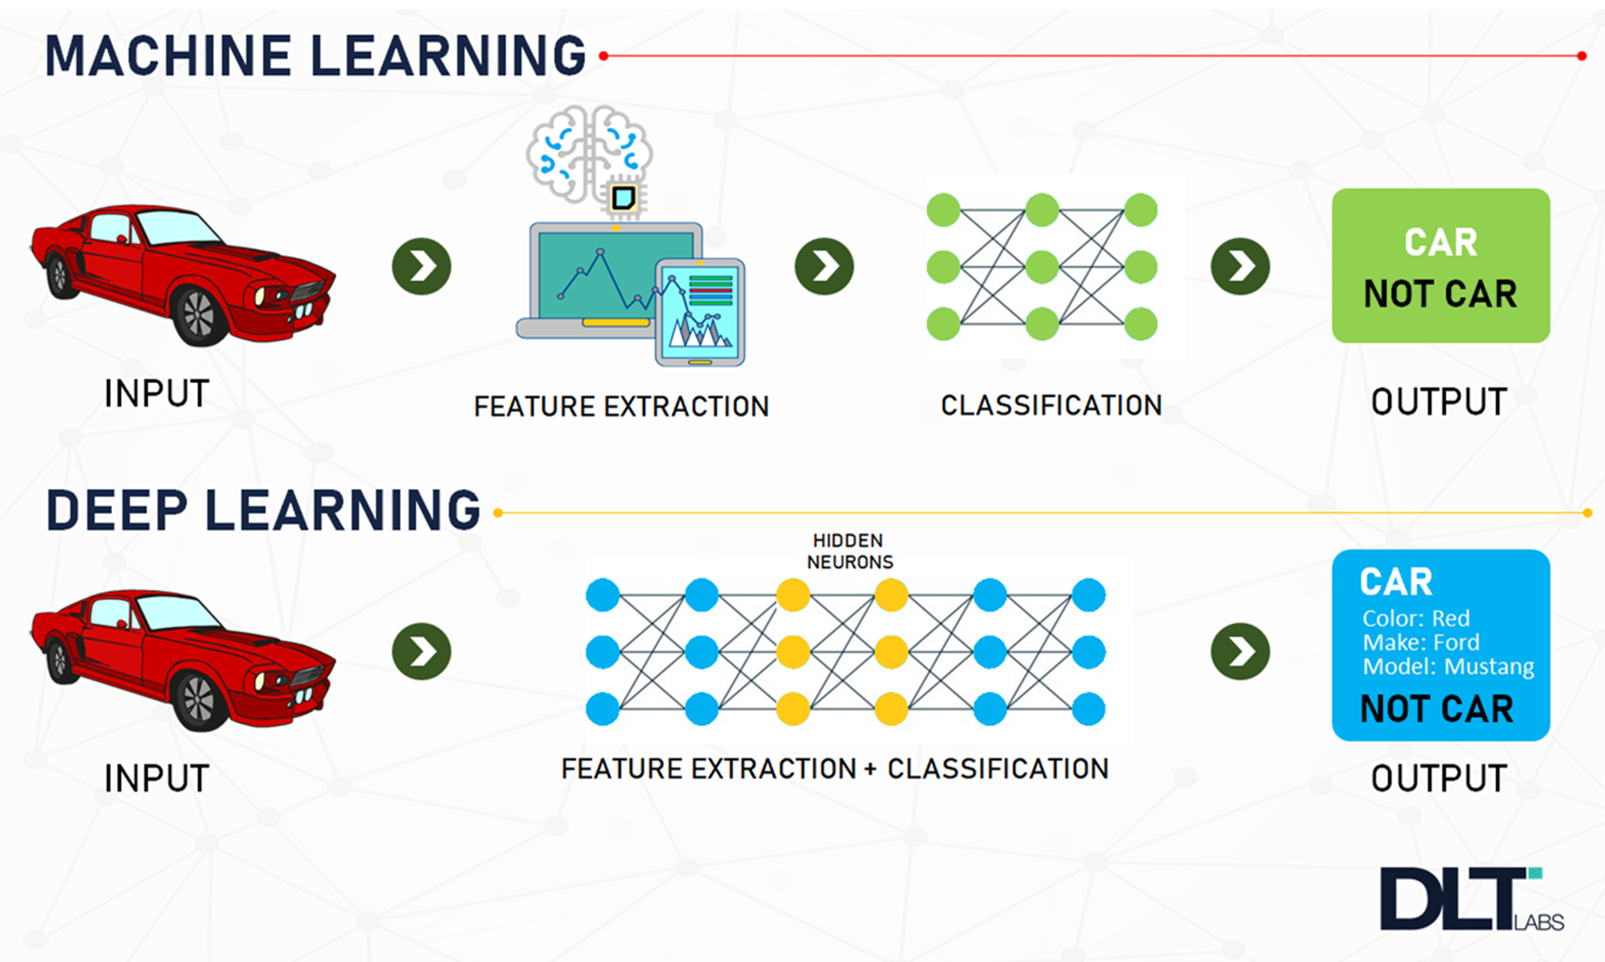

Slide 6
TRAINING DATASET
Training of the network is done by a dataset named MNIST dataset.
MNIST dataset has a training set of 60,000 examples, and a test set of 10,000 examples.
All the images in the dataset are of 28×28 pixels.
It is a good database for people who want to try learning techniques and pattern recognition methods on real-world data while spending minimal efforts on preprocessing and formatting.

Slide 7
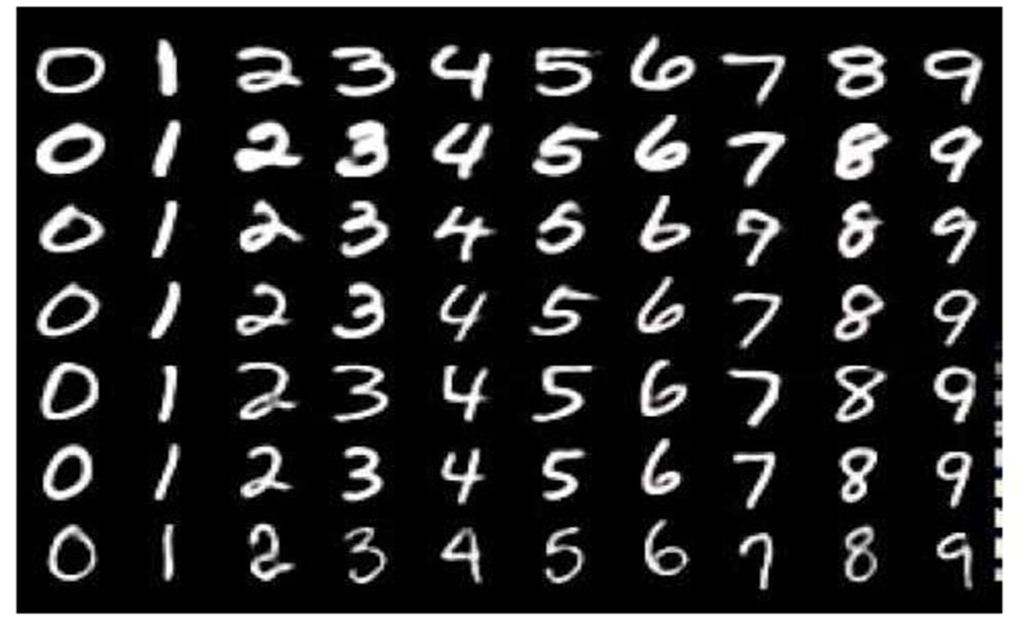

Slide 8



LIBRARIES USED

Slide 9
IMPORTED LIBRARIES
TensorFlow:
It is a free and open-source software library for machine learning. It can be used across a range of tasks but has a particular focus on training and inference of deep neural networks.
It is a symbolic math library based on dataflow and differentiable programming.
It is used to create deep learning models directly by using wrapper libraries and simple the process for large numerical computations.
Keras:
It is an open-source software library that provides a Python interface for artificial neural networks. Keras acts as an interface for the TensorFlow library. Up until version 2.3 Keras supported multiple backends, including TensorFlow.
OpenCV:
OpenCV is a huge open-source library for computer vision, machine learning, and image processing. OpenCV supports a wide variety of programming languages like Python, C++, Java, etc. It can process images and videos to identify objects, faces, or even the handwriting of a human

Slide 10
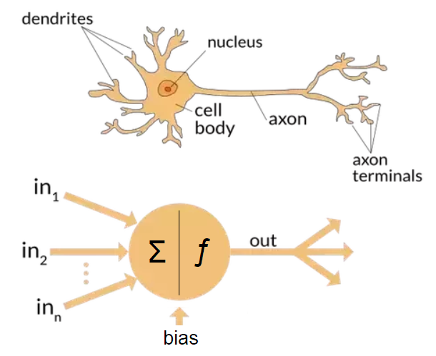
What is Neuron?
Within an artificial neural network, a neuron is a mathematical function that model the functioning of a biological neuron.
Typically, a neuron compute
the weighted average of its
input, and this sum is passed
through a nonlinear function,
often called activation function,
such as the sigmoid.

Slide 11
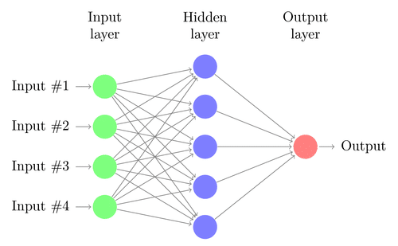
What are Neural Networks?
Artificial neural networks, usually called neural networks (NNs), are interconnected systems composed of many simple processing elements (neurons) operating in parallel whose function is determined by-
1) Network Structure
2) Connection Strengths
3) The Processing performed
at Computing elements or
nodes.

Slide 12
Why convolutions?
Convolution is a simple mathematical operation between two matrices in which one is multiplied to the other element wise and sum of all these multiplications is calculated.
Convolutions are performed for various reasons-
• Convolutions provide better feature extraction
• They save a lot of computation compared to ANNs.
• Less number of parameters are created than those in pure fully connected
layers. • Due to less number of required parameters, lesser fully connected layers are
needed.

Slide 13
Convolutional Neural Networks
CNNs are a special type of neural networks.
They can be divided into two parts: A feature learning part and a classification part.
Each part consists of one or multiple layers.
Feature learning is typically done by combining two types of layers: Convolution layers and pooling layers .
Classification is then performed based on the learned features through dense layers, also known as fully connected layers.
Additionally there is an input layer, containing the image data, as well as an output layer, containing the different classes we are trying to predict .
Layers that are in-between the input and output layer are also referred to as hidden layers as there state is not directly visible when treating the model as a black box.

Slide 14
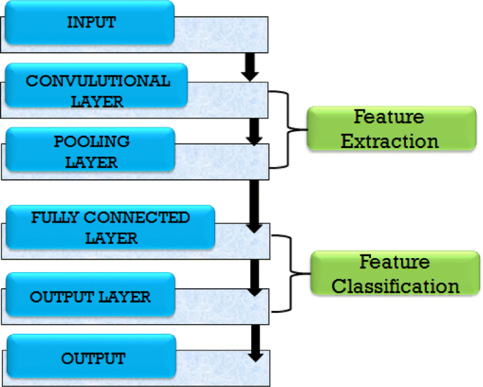
Flowchart for CNN

Slide 15
Convolution Layers
The convolution layer which is responsible for feature extraction from an input data.
This layer performs convolution operation to small localized areas by convolving a filter with the previous layer. In addition, it consists of multiple feature maps with learnable kernels and rectified linear units (ReLU).
The kernel size determines the locality of the filters i.e. how many of the surrounding pixels are being taken into account when applying the filter. Secondly, we need to pick a stride value. The stride determines how many pixels we advance when convolving. A stride of 1 will move the filter across every pixel, while a stride of 2 will skip every second pixel.
ReLU is used as an activation function at the end of each convolution layer as well as a fully connected layer to enhance the performance of the model

Slide 16
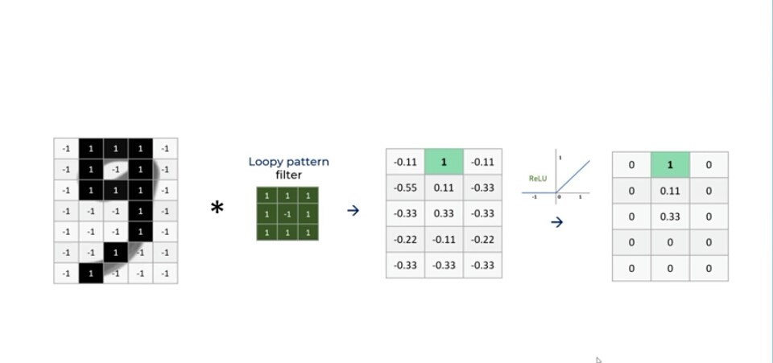

Slide 17
Pooling Layers
It reduces the output information from the convolution layer and reduces the number of parameters and computational complexity of the model.
The different types of pooling are max pooling, min pooling, average pooling , and L2 pooling. Here, max pooling is used to subsample the dimension of each feature map.
In max pooling we select the maximum value of the sub-region for our sub-sampled output. In the next figure we can see the result of applying 2×2 max-pooling to a 4×4 input matrix.

Slide 18
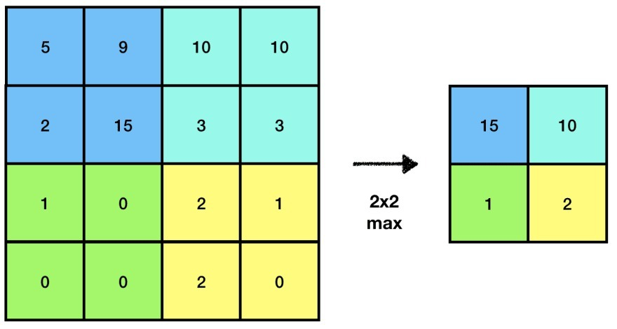

Slide 19
Dense Layers
A Flatten layer is used after the pooling layer which converts the 2D featured map matrix to a 1D feature vector and allows the output to get handled by the fully connected layers.
A fully connected layer is another hidden layer also known as the dense layer. Dense layers connect every neuron from the previous layer to the next one. In the context of CNNs they form the classification part of the network. Neurons in the dense layers learn which features each class is composed of.

Slide 20
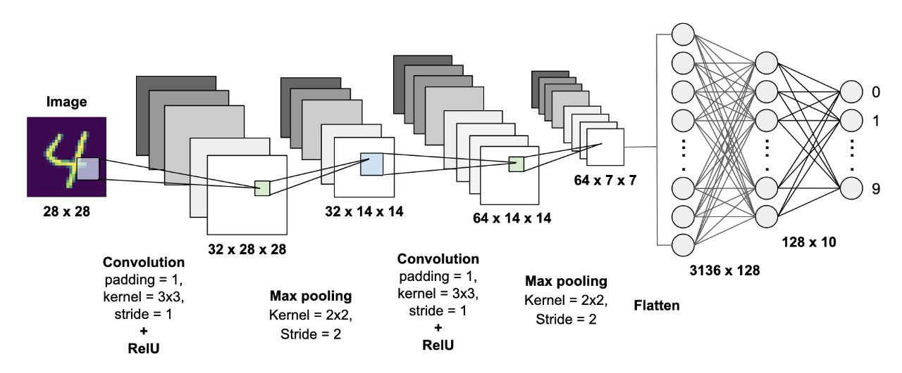

Slide 21

Loading Dataset

Slide 22
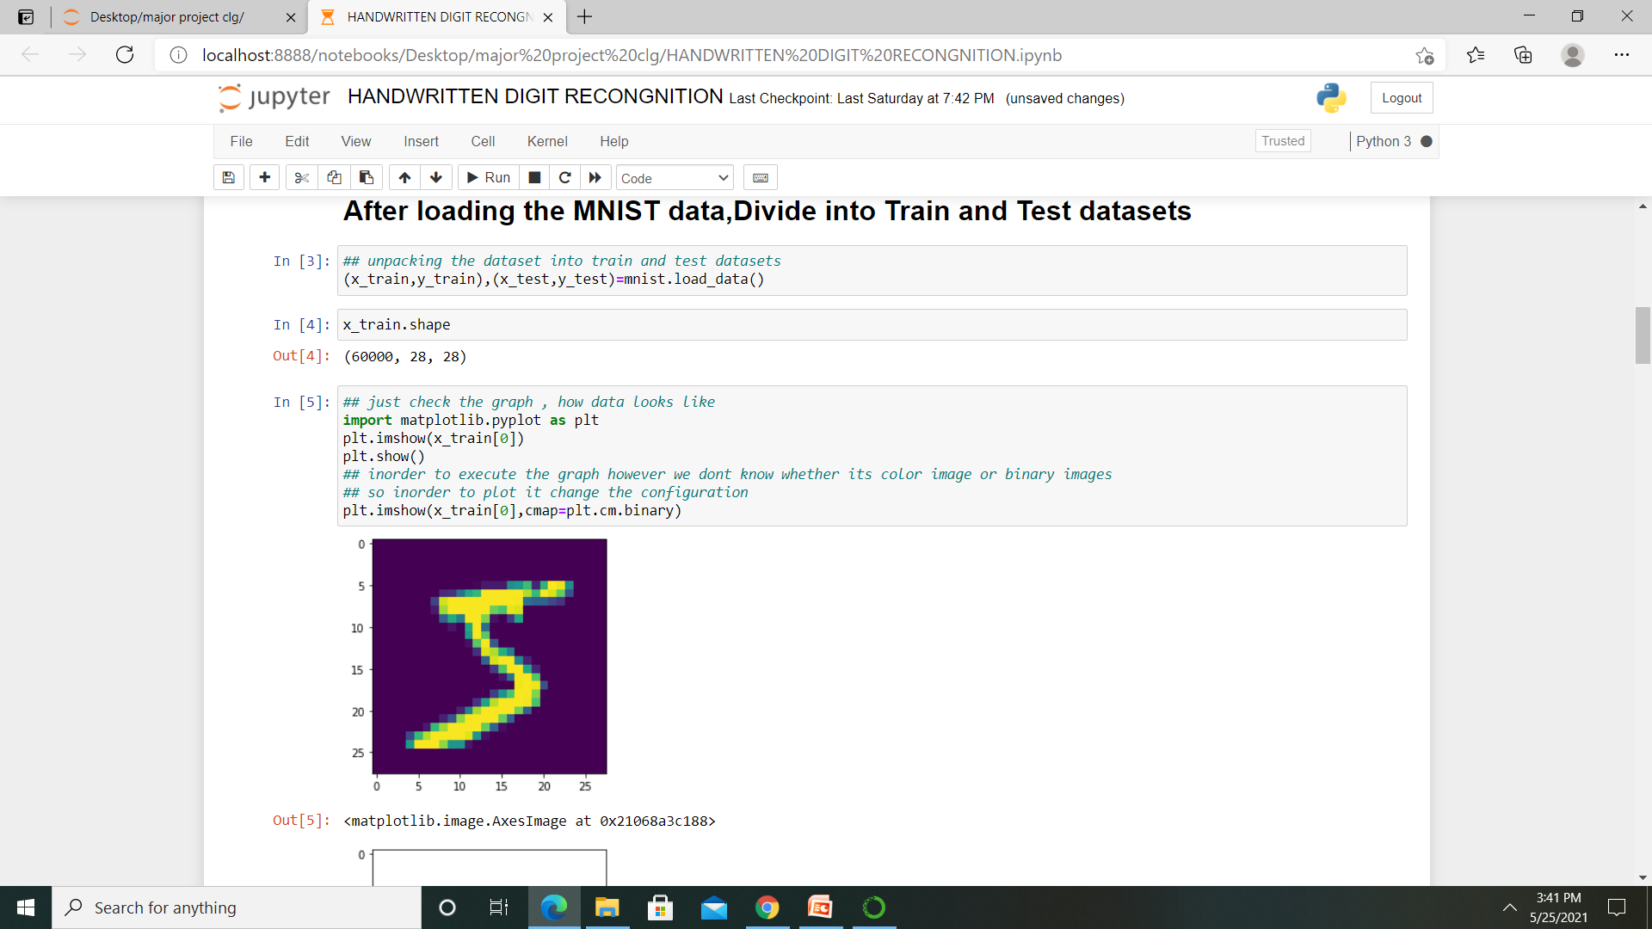
Divide in to Train and Test Datasets

Slide 23
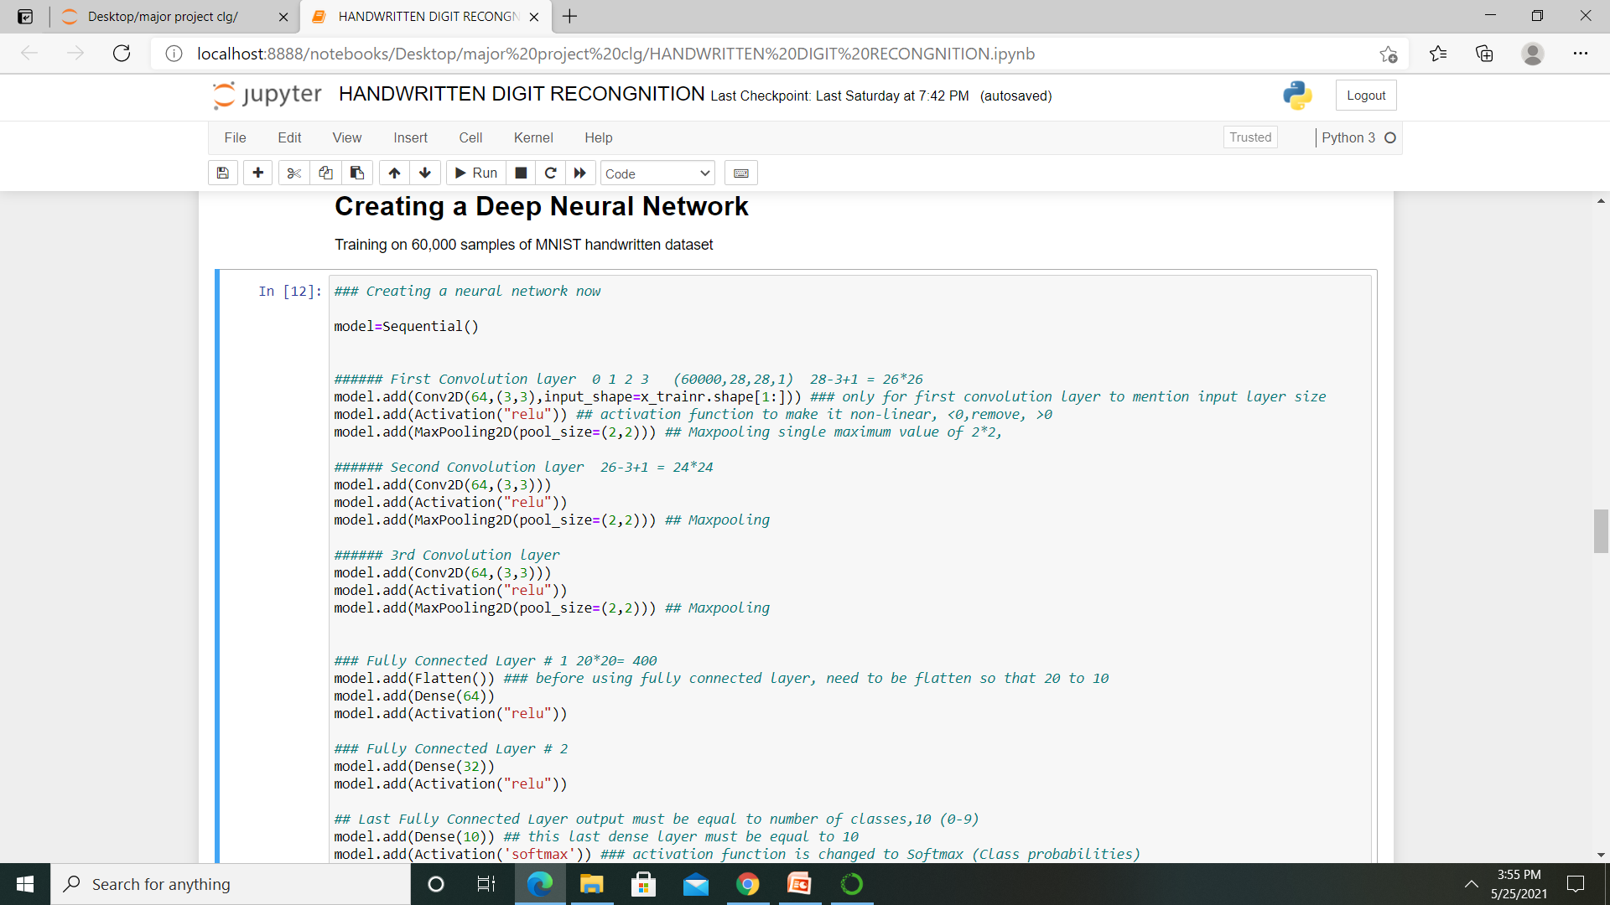
Creating a Deep Neural Network

Slide 24
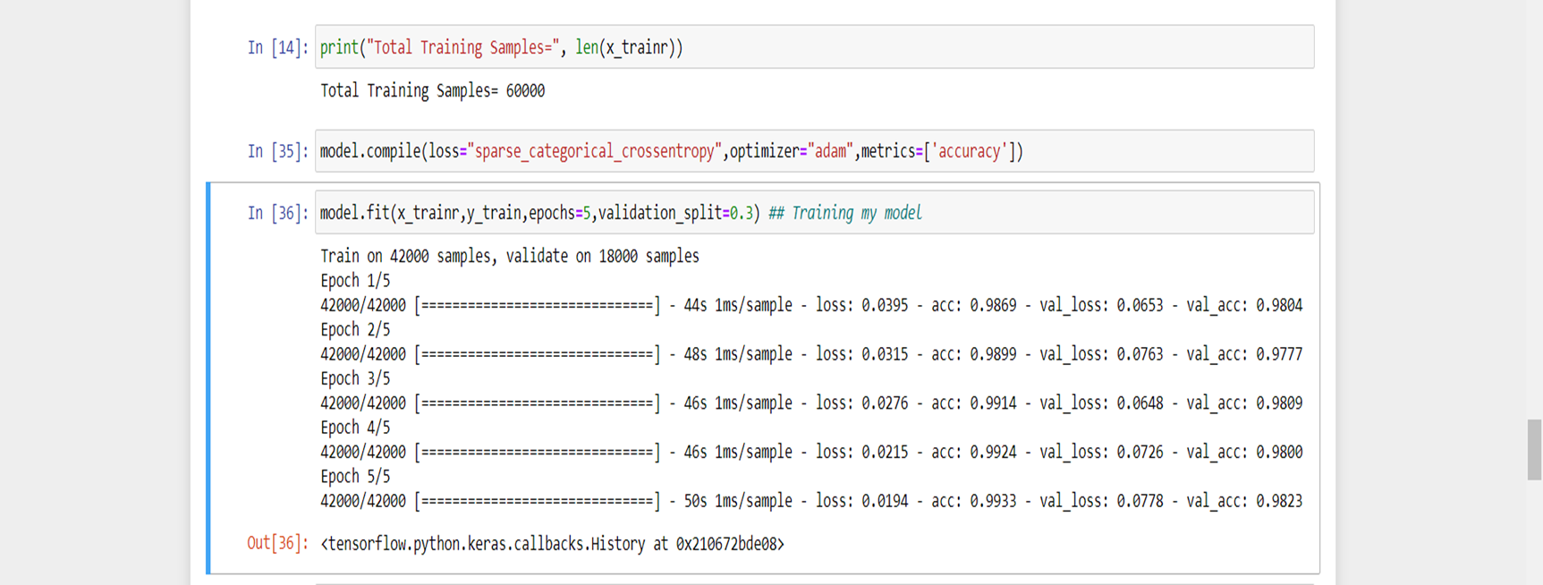
Training the Model
Accuracy obtained on training samples : 99%

Slide 25
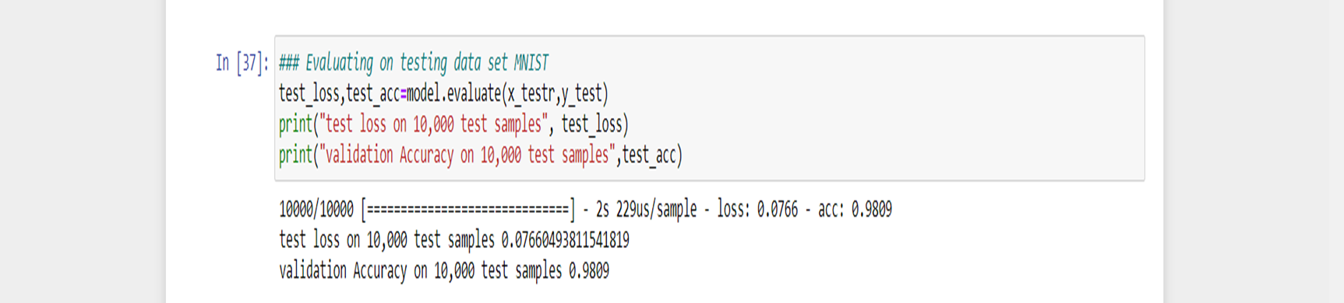
Evaluating On Testing Dataset
Accuracy obtained on 10,000 test samples : 98%

Slide 26

Predictions Using this model
Taking Input from Paint(Handwritten Digit 3)

Slide 27
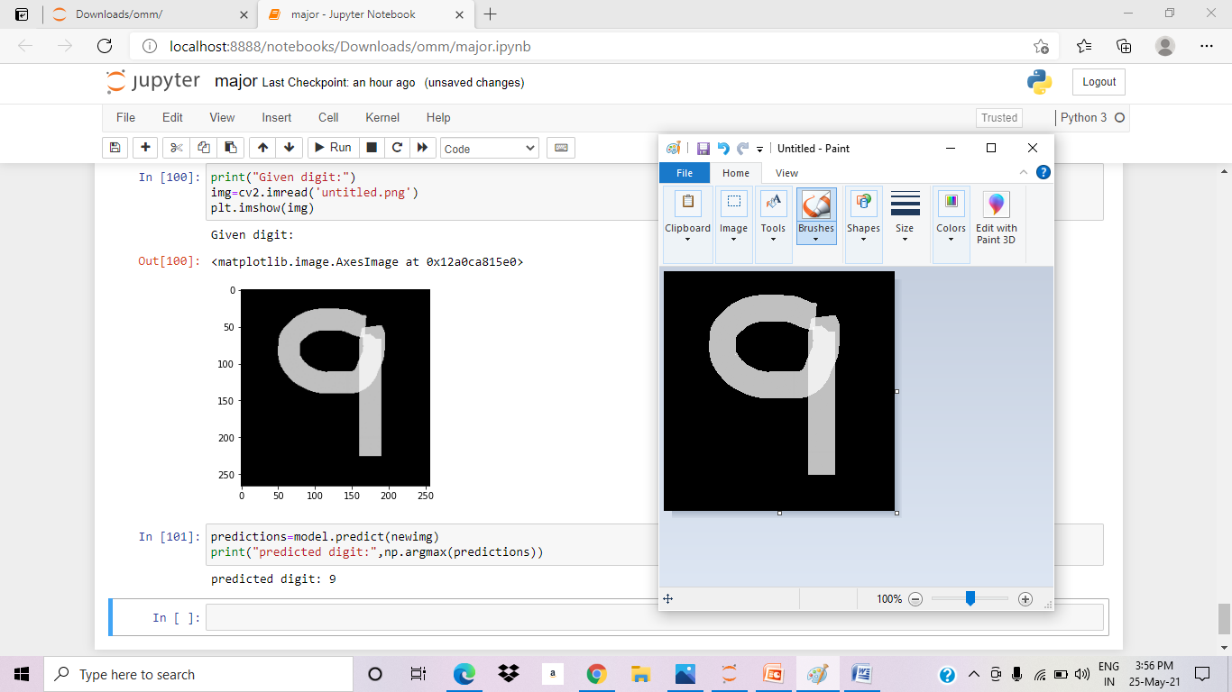
Input : Handwritten Digit 9

Slide 28
CONCLUSION
The handwritten digit recognition using CNN has provided to be of a fairly good efficiency.
It works better than any other algorithm, including artificial neural networks.
We can conclude that we reached the computer to the human’s brain by the importance, use of isolated digits recognition for different applications.
The main applications are vehicle license-plate recognition , postal letter-sorting services , Cheque Truncation System(CTS) scanning ,old documents automation in libraries and banks, etc.

Slide 29
Thank you!

